Slide 1
GPS/INS/Wheel Count
Sensor Acquisition and Fusion

Slide 2
What do GPS, INS, and Wheel Counts do?
Report and record the position of the robot
  Position relative to a starting position for INS and wheel count.
  GPS gives location in Latitude and Longitude

Slide 3
Why do we need three methods to determine position?
All three systems use different methods to calculate location.
By looking at all three, a better approximation of position can be established.
Redundancy
The weaknesses of each system can be offset by the other systems.

Slide 4
Sensor Function Overview
GPS: Triangulates position by sending signals to a satellite array. Time to receive signals from different satellites allows calculation of position.
  Strengths: gives latittude/longitude readings anywhere in the world. No drifting of measurement.
  Weaknesses: inaccuracies, outages

Slide 5
Sensor Function Overview
INS (Inertial Navigation System) uses a set of rate gyroscopes and accelerometers mounted on each of the three axis.
  Strengths: fast refresh, accurate values, fairly reliable with no outages.
  Weaknesses: drifts over time
Wheel Count measures the number of rotations of each wheel.
  Strengths: Works consistently, simple system
  Weaknesses: No way to measure wheel slip.

Slide 6
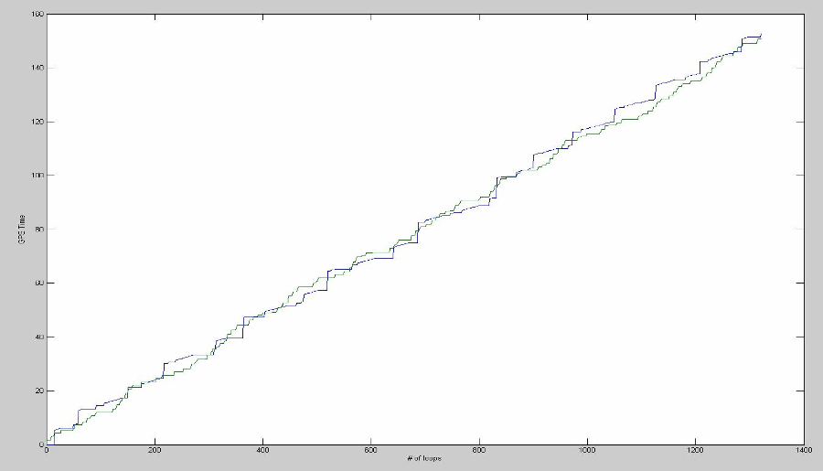
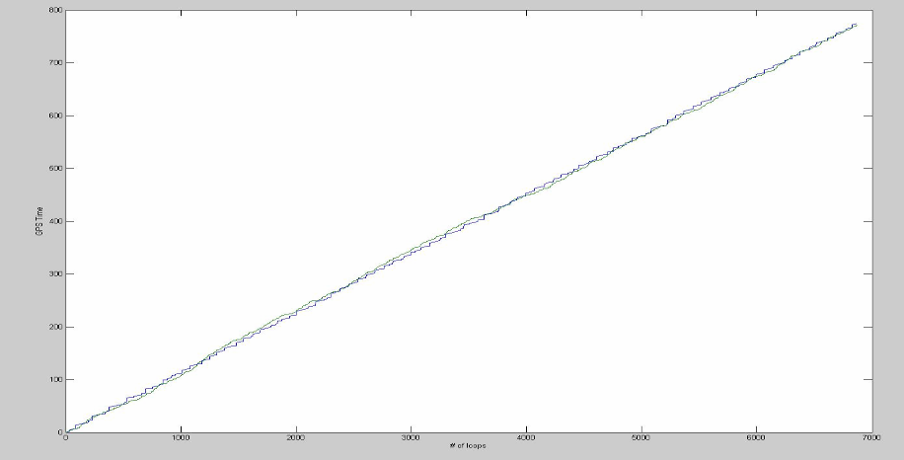
Modeling System Clock to GPS Time
GPS has relatively large update time
Unacceptable for Speed based GPS estimates
dt(GPS) = loop_time * a
A = 30.1794071763

Slide 7
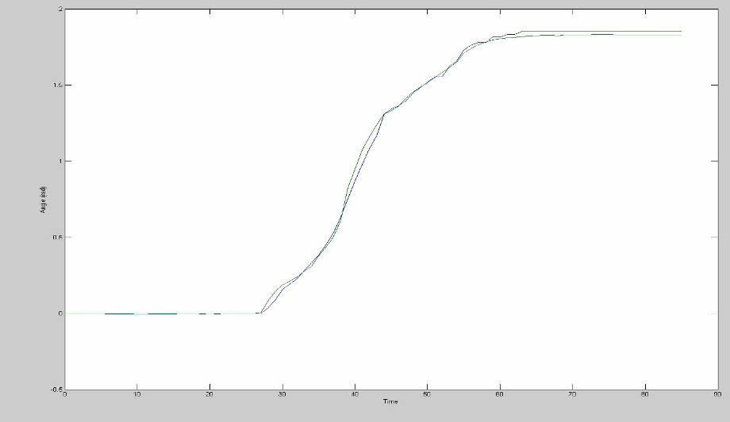
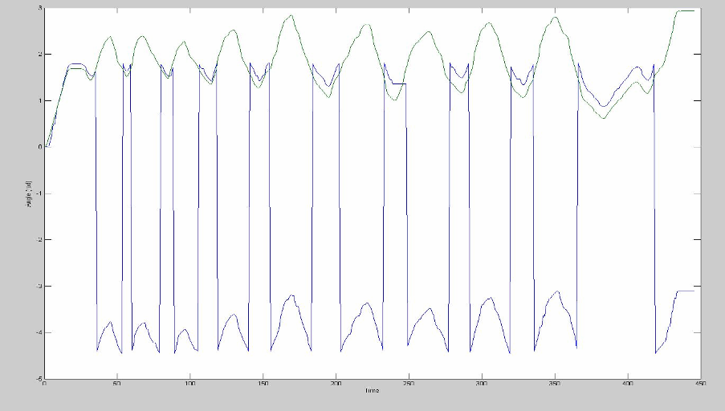
Modeling Dead Reckoning Angle to Gyroscope Angle
Both initialize to –pi/2
Differences are related to wheel slip
Simple degrees to radians conversion
Implementation requires infrequent linking

Slide 8
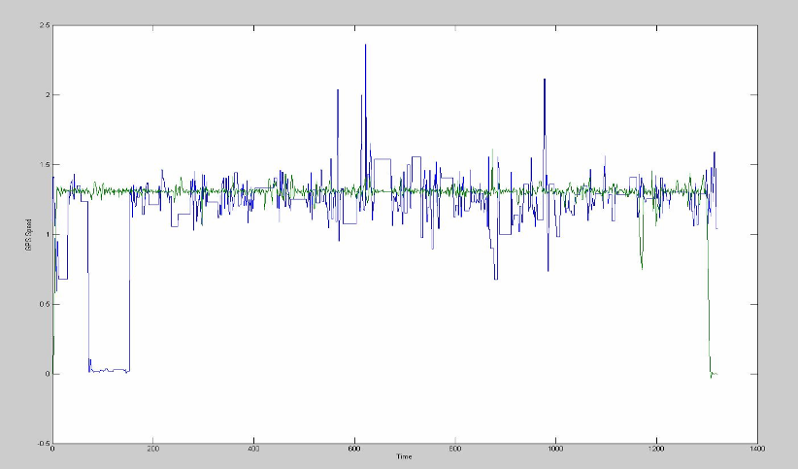
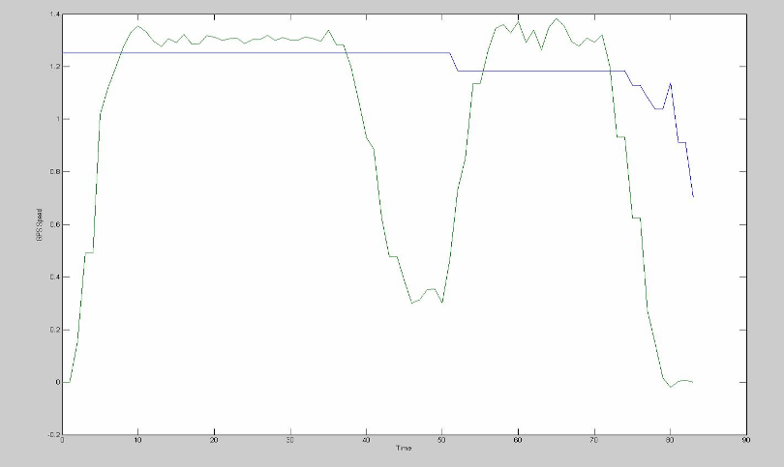
Wheel speed to GPS speed
Sporadic GPS speed
Conversion based on experimental data
GPS speed = wheel_speed*b
b =.628734687354

Slide 9
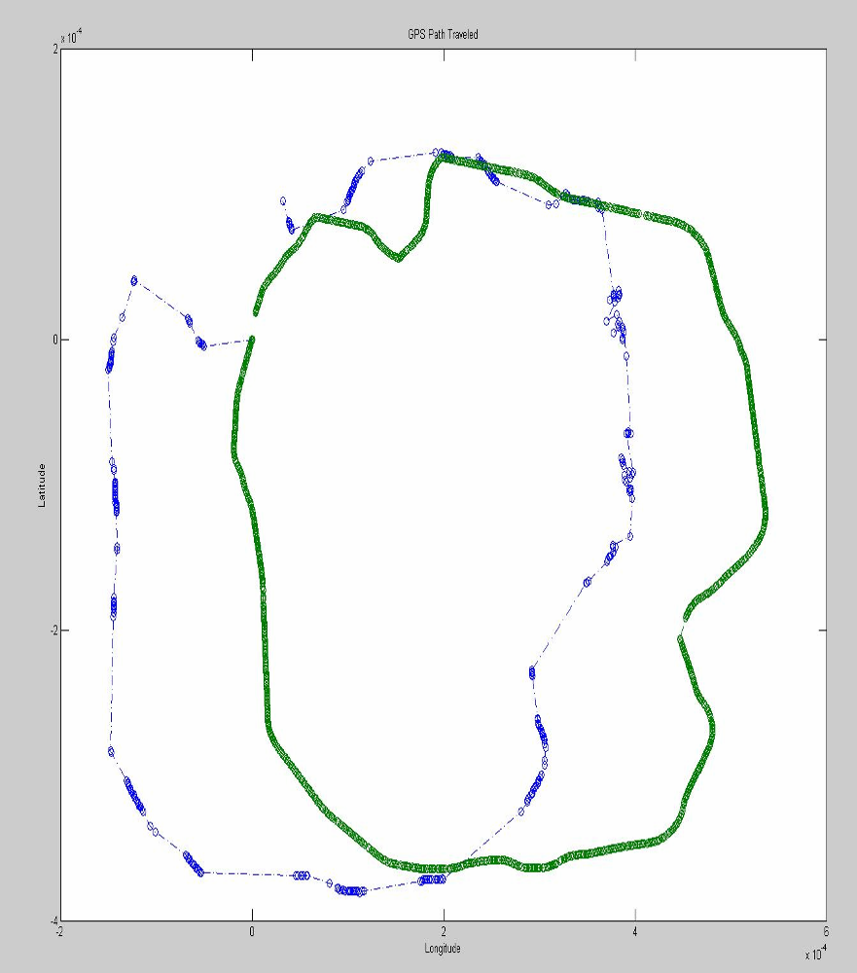
(X, Y) Coordinates to
GPS Longitude and Latitude
latlen = m1 + (m2.*cos(2.*gps_lat))+ (m3.*cos(4.*gps_lat)) + (m4.*cos(6.*gps_lat))
longlen = (p1 * cos(gps_lat)) + (p2.*cos(3.*gps_lat)) + (p3.*cos(5.*gps_lat))
Two sets of (x,y) coordinates
  (x,y) and (x+dx/dt,y+dy/dt)
Difference between points as a vector
Rotate Vector to match GPS angle
  New_angle = original angle-GPS_angle_offset
Convert from meters to degrees
Add to current GPS latitude and longitude to get new value

Slide 10
Inertial Navigation System Implementation (ins_conv.c)
get_gps_est(double est_long, double est_lat, double est_speed, double est_angle, double est_loop_time, int sys_num, double x, double y,double link_offset_angle, rstatus r)
  System I: GPS only
  System II: Dead Reckoning to GPS
  System III: Wheel Speed and Gyroscope to GPS
  System IV: GPS Speed and Gyroscope to GPS
link_gyro_angle_to_gps

Slide 11
Sensor Fusion
By combining all sensor inputs and finding “average”, weaknesses of each system can be factored out.
Kalman filter is the most common method to integrate this sensor data.

Slide 12
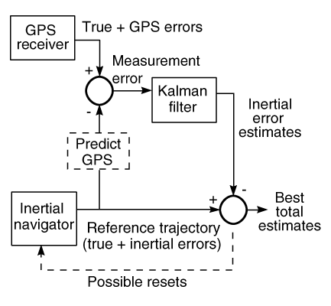
Kalman Filter
  A digital filter which uses a recursive process to determine a least-squares fit to data obtained over time. MIMO, filter for noisy sensor data.
  Works on a theory of states with uncertainties added in at each recursion. The uncertainties and weights are updated and improved during each cycle.
Source: http://www.cs.unc.edu/~welch/kalman/Levy1997/fig6.htm
The Kalman Filter: Navigation's Integration Workhorse by Larry J Levy

Slide 13
Where would we go from here?
Add full INS system to robot.
Implement real-time Kalman filter including full INS and GPS data.

